Slide 1
Cosmos DB
console application in C#
(quickStart)

Slide 2
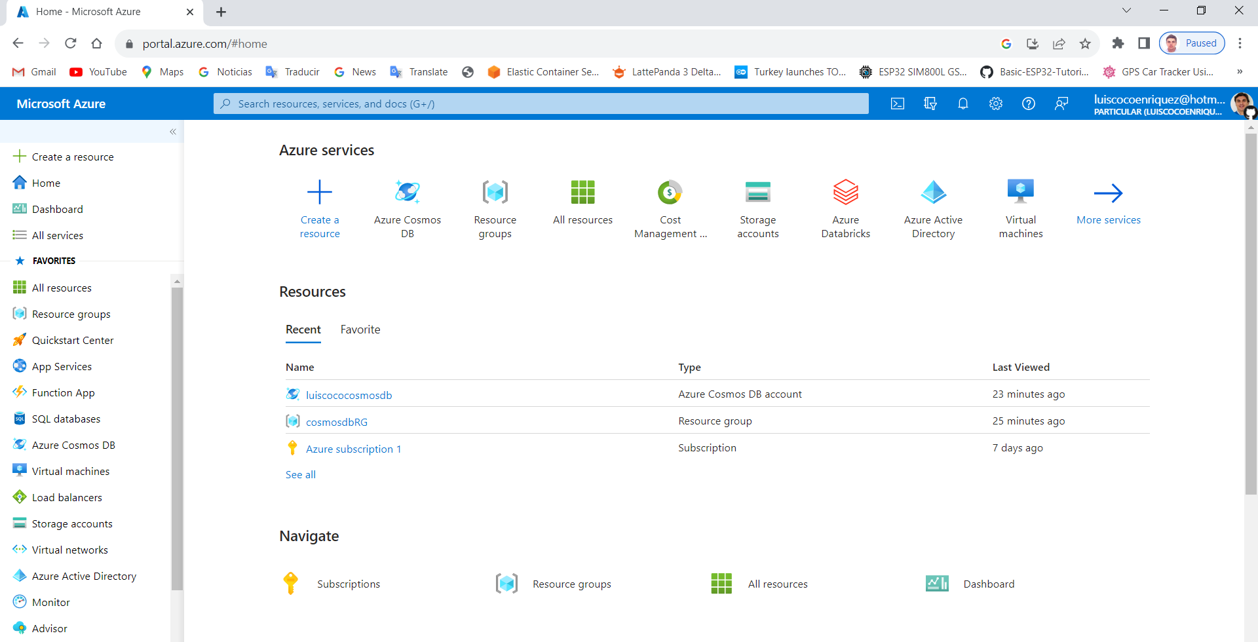
1. Login in the Azure portal and select Azure CosmosDB

Slide 3
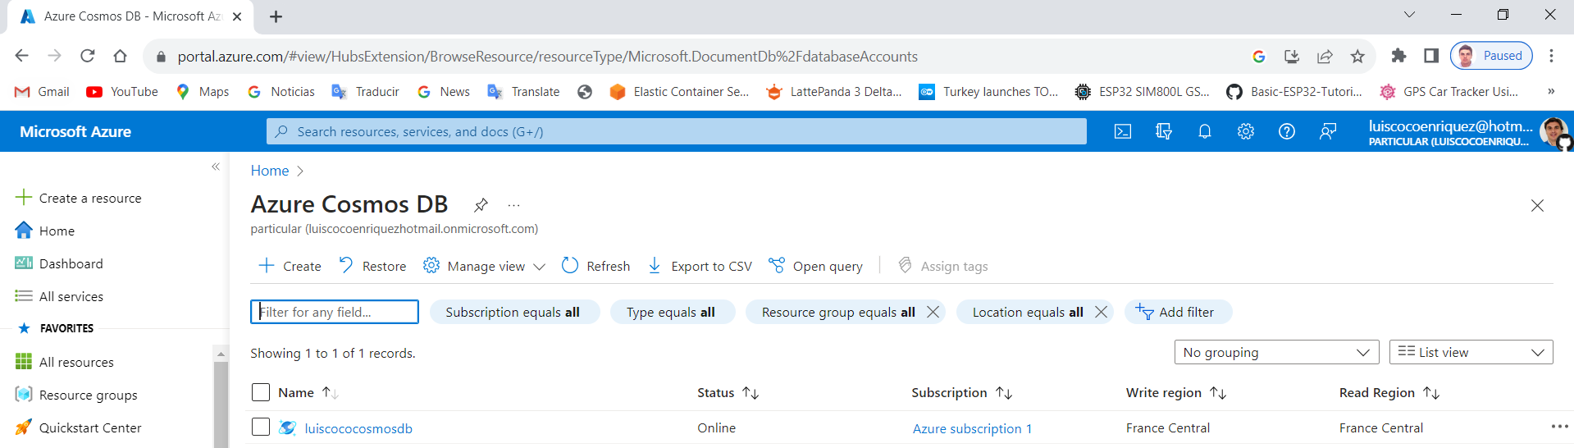
2. Press the “Create” button in the Azure CosmosDB

Slide 4
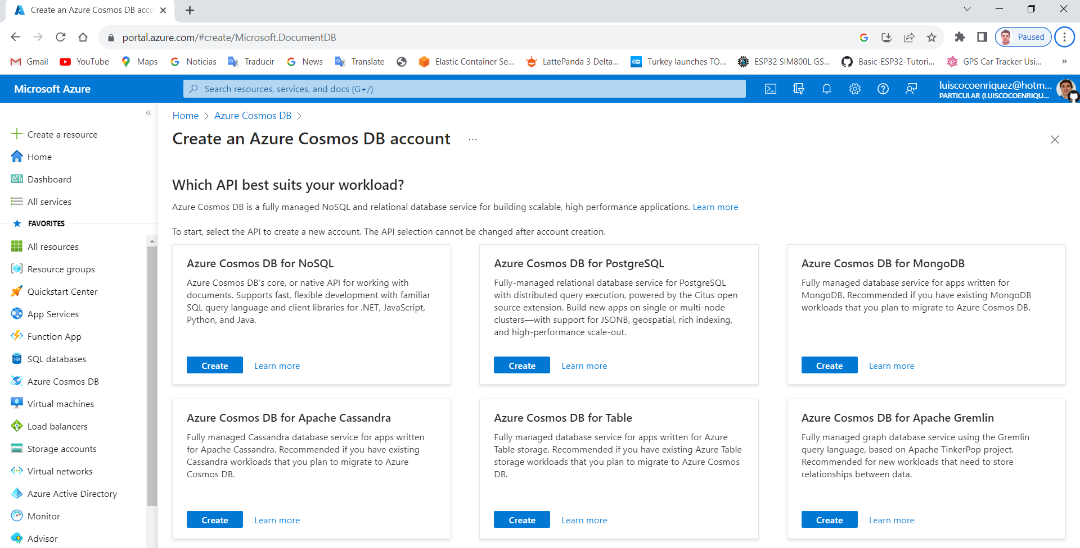
3. Press the “Create” button in the Azure CosmosDB for NoSQL

Slide 5
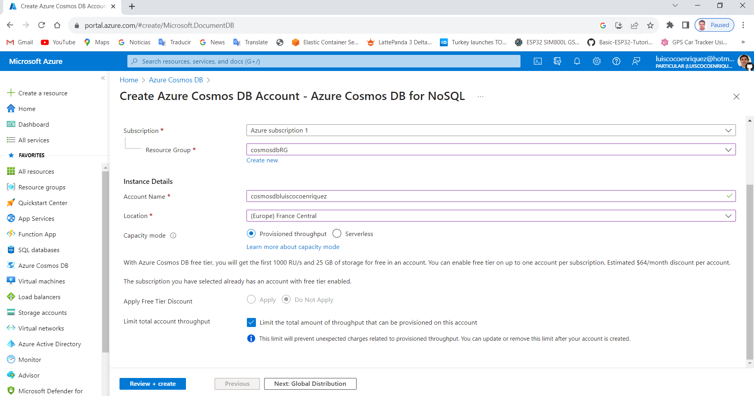
4. Set the Subscription, the resource group, the account name, the location, select the capacity mode, apply the free tier discount, limit total account throughput and press the button “Review + create”

Slide 6
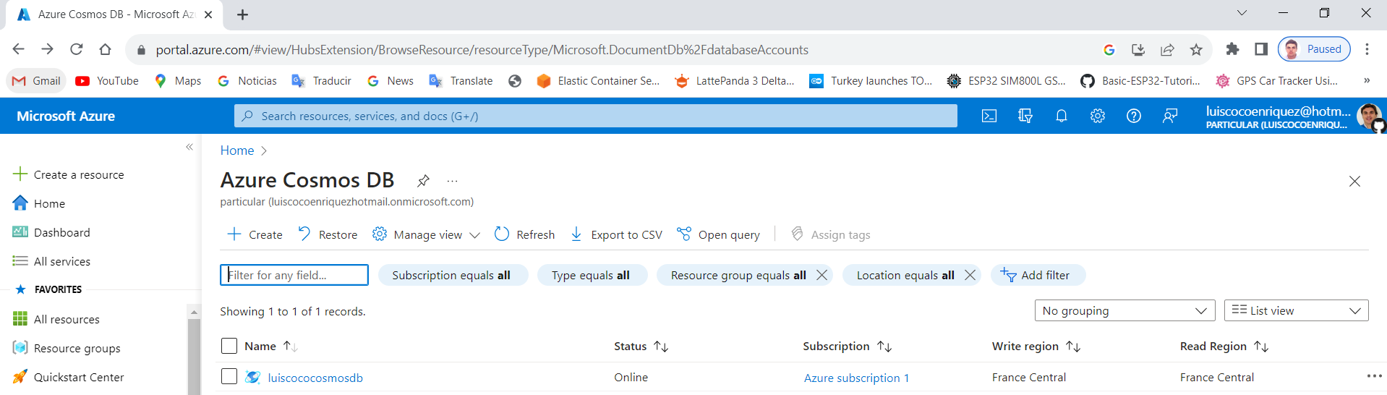
5. Press the CosmosDB link “luiscococosmosdb” to navigate to the Azure CosmosDB account

Slide 7
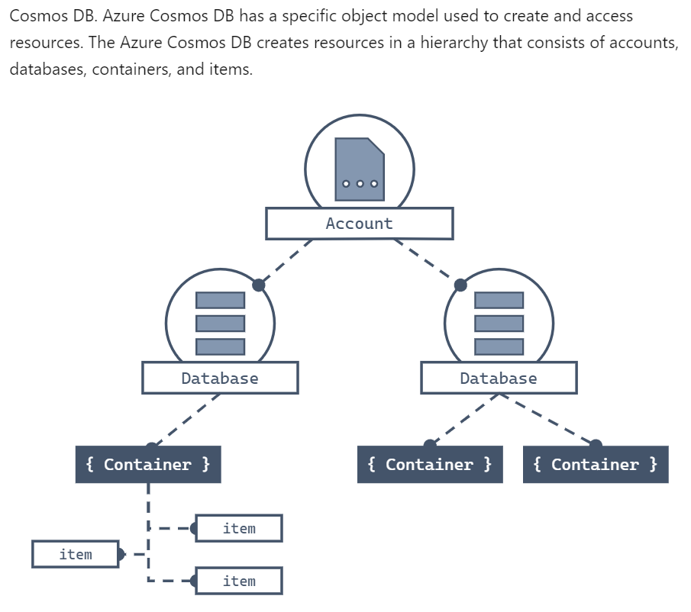

Slide 8
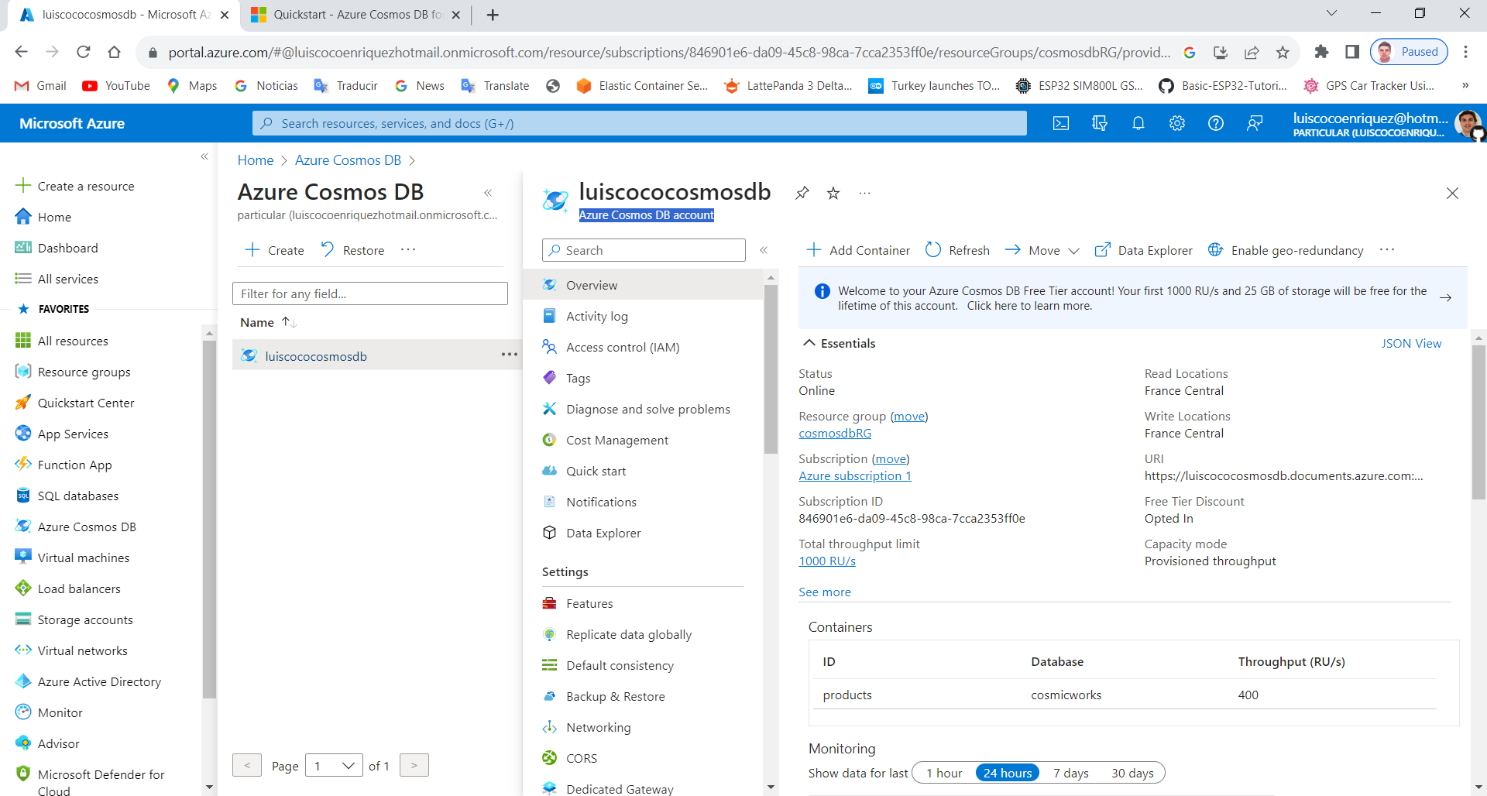
6. Press the CosmosDB link “luiscococosmosdb” to navigate to the Azure CosmosDB account

Slide 9
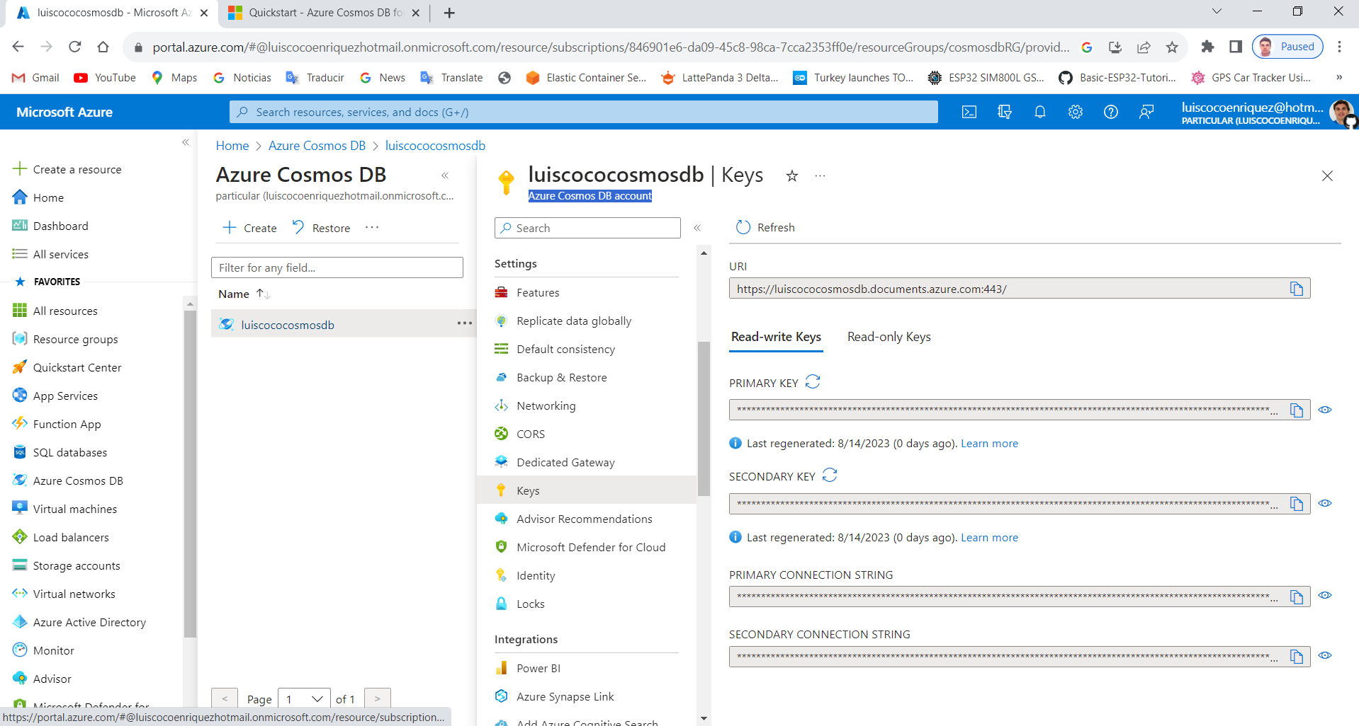
7. In the Azure CosmosDB account go to the “Keys” option

Slide 10
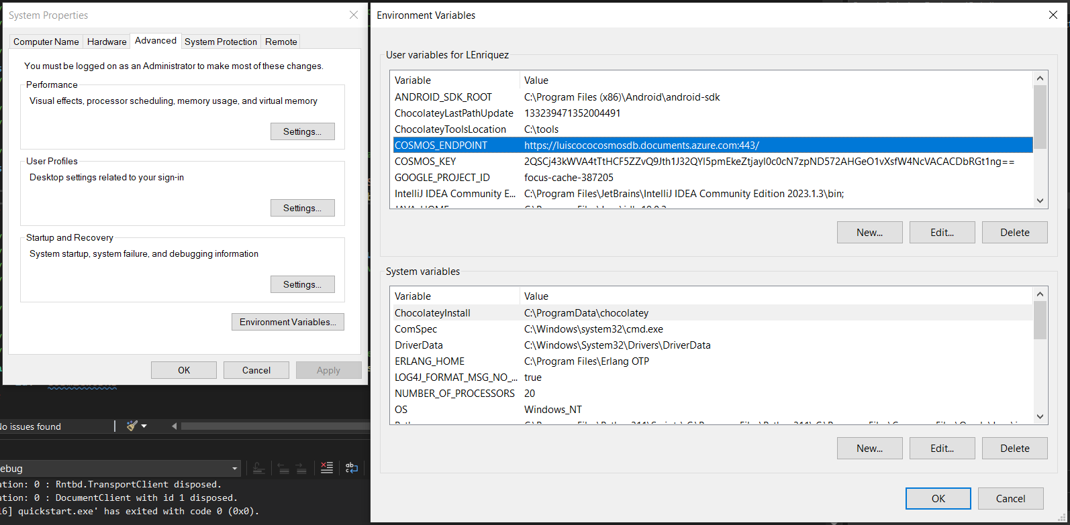
8. Set the environmental variables values: the COSMOS_ENDPOINT and the COSMOS_KEY

Slide 11
// ------------------------------------------------------------
// Copyright (c) Microsoft Corporation. All rights reserved.
// ------------------------------------------------------------
// <using_directives>
using Microsoft.Azure.Cosmos;
// </using_directives>
// <client_credentials>
// New instance of CosmosClient class
//We need to set these two variable in the Environment Variables...
using CosmosClient client = new(
accountEndpoint: Environment.GetEnvironmentVariable("COSMOS_ENDPOINT")!,
authKeyOrResourceToken: Environment.GetEnvironmentVariable("COSMOS_KEY")!
);
// </client_credentials>
// <new_database>
// Database reference with creation if it does not already exist
Database database = await client.CreateDatabaseIfNotExistsAsync(
id: "cosmicworks"
);

Slide 12
Console.WriteLine($"New database:\t{database.Id}");
// </new_database>
// <new_container>
// Container reference with creation if it does not already exist
Container container = await database.CreateContainerIfNotExistsAsync(
id: "products",
partitionKeyPath: "/categoryId",
throughput: 400
);
Console.WriteLine($"New container:\t{container.Id}");
// </new_container>
// <new_item>
// Create new object and upsert (create or replace) to container
Product newItem = new(
id: "70b63682-b93a-4c77-aad2-65501347265f",
categoryId: "61dba35b-4f02-45c5-b648-c6badc0cbd79",
categoryName: "gear-surf-surfboards",
name: "Yamba Surfboard",
quantity: 12,
sale: false
);
Product createdItem = await container.CreateItemAsync<Product>(
item: newItem,
partitionKey: new PartitionKey("61dba35b-4f02-45c5-b648-c6badc0cbd79")
);

Slide 13
// <query_items>
// Create query using a SQL string and parameters
var query = new QueryDefinition(
query: "SELECT * FROM products p WHERE p.categoryId = @categoryId"
)
.WithParameter("@categoryId", "61dba35b-4f02-45c5-b648-c6badc0cbd79");
using FeedIterator<Product> feed = container.GetItemQueryIterator<Product>(
queryDefinition: query
);
while (feed.HasMoreResults)
{
FeedResponse<Product> response = await feed.ReadNextAsync();
foreach (Product item in response)
{
Console.WriteLine($"Found item:\t{item.name}");
}
}
// </query_items>

